Slide 1
Chaired by
Paul Nisbett, Chairman, Finance Committee – HOSPA
Speakers
Richard Harrington – Regional Director of Finance, Langham Hotels
David Nicolson – VP Finance, Europe, Jumeirah Group
Cesco Righetti – Director of Finance, Bulgari Hotel & Residences

Slide 2
Agenda
Recap the changes in the new edition
Summary Operating Statement
Multi-Department Changes
Operating Department
Undistributed Departments
Non-Operating Income and Expenses
Financial Statements
Financial Ratios and Operating Metrics
Revenue and Expense Guide
How each hotel has implemented the new edition from Jan 2015
Discuss the challenges and issues that have arisen out of adoption of the new edition

Slide 3
Purpose
“to provide operating statements that are formatted to provide hotel owners, managers and other interested parties with information and data that are specific to the hotel industry.”

Slide 4
Summary Operating Statement
Operating Revenue
Rooms
Food and Beverage
Other Operated Departments
Miscellaneous Income
Total Operating Revenue

Slide 5
Summary Operating Statement
Undistributed Operating Expenses
Administrative and General
Information and Telecommunications Systems
Sales and Marketing
Property Operations and Maintenance
Utilities
Total Undistributed Expenses
Gross Operating Profit
Management Fees
Income Before Non-Operating Income and Expenses

Slide 6
Summary Operating Statement
Non-Operating Income and Expenses
Income
Rent
Property and Other Taxes
Insurance
Other
Total Non-Operating Income and Expenses
EBITDA (Earnings Before Interest, Taxes, Depreciation, and Amortization)
Less: Replacement Reserve
EBITDA Less Replacement Reserve

Slide 7
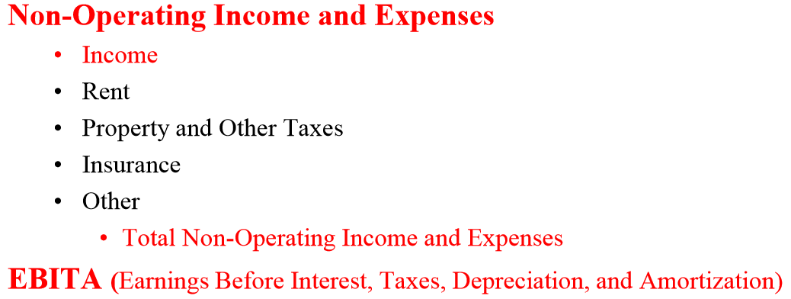

Slide 8
Multiple Departments
Payroll Costs to Labor Costs
Outsourced Labor recognized
Aggregated Salaries and Wages for Management and Non-Management are presented in department schedules
Service Charge Distribution is presented as a cost category
Global approach taken with payroll tax and benefit categories

Slide 9
Labor Reporting
Labor Costs and Related Expenses
Salaries, Wages, Contracted Labor and Bonuses
Salaries and Wages
Management
Non-Management
Sub-Categories as needed
Sub-Total: Salaries and Wages
Service Charge Distribution
Contracted, Leased or Outsourced Labor
Bonuses and Incentives
Total Salaries, Wages, Service Charges, Contracted Labor & Bonuses
Payroll-Related Expenses
Payroll Taxes
Supplemental Pay
Employee Benefits
Total Payroll Related Expenses
Total Labor Costs and Related Expenses

Slide 10
Operating Departments
Room Revenue Segmentation
Package Revenue language clarified and package breakage treatment addressed
Additional Complimentary Services and Gifts expense category
F&B
In-Room/Media Entertainment

Slide 11
Rooms Revenue Segments
10th Edition | 11th Edition
Transient - Commercial/ Corporate - Leisure - Government/ Military - Frequent Guest/ Preferred - Travel Packages, FIT - Hotel Packages - Internet | Transient - Retail - Discount - Negotiated - Qualified - Wholesale
Group - Corporate - Association/ Convention - Government - Tour group - SMERF - Wholesale | Group - Corporate - Association/ Convention - Government - Tour group / Wholesale - SMERF
Contract | Contract
Material Change in Transient Segments; Added Definitions
More detailed room revenue reporting, with segmentation more aligned with revenue management definitions
Minor Change in Group Segments; Added Definitions
Notes:
Moving to slide #25
This slide compares the Rooms Revenue Segments - 10th edition vs. the 11th edition.
There was a strong desire to “beef up” the guidance around rooms revenues and be more aligned with current practices/thinking. This resulted in 3 primary revisions:
Revised the sub-segments under Transient and Group, although the major changes were all in Transient
Revised the face of the Rooms Dept operating statement (Schedule 1) to show all of these sub-segments
10th edition showed Transient, Group and Contract
11th edition shows 5 sub-segments under Transient and Group
Provided definitions for each of the sub-segments
Again, these revisions reflect a great partnership with the experts in Revenue Management.

Slide 12
Food and Beverage
Combined Food and Beverage Operations
Audio Visual revenue recognition expanded
Public Room set-up charges added
Cost of sales reclassification
Gift certificate revenue recognition expanded
Cover renamed as Customer

Slide 13
Surcharges & service Charges
Food and Beverage surcharges and service charges are consolidated in Other Revenue.
Surcharges and Service Charges generally include any mandatory, non-discretionary, or other charge automatically added to a customer account in respect of the use of a service or amenity, and may include, but are not restricted to, such items as:
Item | Revenue Recorded as
Banquet service charge Restaurant service charge Rooms service delivery charge Corkage charge | F&B Other Revenue F&B Other Revenue F&B Other Revenue F&B Other Revenue
The key determining factors for the recording of Surcharges and Service Charges are set out in the Gross vs Net reporting section. The property must assess whether it is acting as an Agent or as Principal in the transaction in order to make a determination on reporting the revenue from that transaction on a gross or a net basis.
Notes:
OTHER REVENUES includes
Surcharges and Service Charges which are generally defined to include MANDATORY, NON-DISCRETIONARY charges or other charges that are AUTOMATICALLY added to a customer account. These may typically include Banquet or Restaurant Service Charges, Room Service delivery charges, or corkage charges.
As is the case with AUDI VISUAL revenue, the key determining factor for the recording of Surcharges and Service Charges are set forth in the Gross vs. Net reporting in PART V of the book. The property must assess whether it is acting as an Agent or Principal in the transaction.

Slide 14
Gift Certificates
Included in Miscellaneous Other Revenue are unused or forfeited deposits related to gift certificates that are not otherwise required to be escheated to the state or local jurisdiction, or un-presented and expired prepaid food and beverage coupons.

Slide 15
Telecommunications
No longer an Other Operated Department.
Revenues and cost of sales moved to “Guest Communication” in Minor Operated Departments.
Cost of administrative phone calls and internet connectivity moved to new “Information and Telecommunications Systems” department.
Cost of complimentary phone calls and internet connectivity moved to new “Information and Telecommunications Systems” department.
All other telecommunications related expenses (labor, maintenance, operating supplies) moved to new “Information and Telecommunications Systems” department.

Slide 16
Undistributed Departments
Information & Telecommunication Systems
Consolidate all hotel expenses associated for information and telecommunication systems to provide better line of sight cost management
Includes cost of cell phones, administrative call and internet services, and complimentary call and internet services.
System expenses categorized by type of technology or by area benefiting from technology solution.

Slide 17
Undistributed Expenses
Additional guidance regarding the handling of Foreign Currency Exchange income and expenses.
Clarified Revenue Management and Catering Sales Functions as Sales and Marketing expenses.
Utility Taxes was eliminated as a separate expense category in the Utilities Department.
Contract Services was added as an expense category in the Utilities Department.

Slide 18
Non-Operating Income and Expenses
“Fixed Charges Section”.
Changed title from “Rent, Property & Other Taxes and Insurance” to reflect that there are other items affecting the property income statement that are not from hotel operations.
Revenue includes income from other parts of the facility that are not controlled or directed by hotel operations, such as interest income, mobile phone rentals (i.e. substation).

Slide 19
Other Sections
Financial Ratios and Operating Metrics
Expanded
Cover changed to Customer
Utility Ratios expanded
Foundation laid for tracking hotel’s environmental impact
Revenue and Expense Guide
Revenue Guide added
Sortable and searchable format

Slide 21
Resources
Ralph Miller 1 Hour overview
http://video.ahlei.org/webinars/USALI_FIn/USALI_Fin.html
HOSPA

