Slide 1
FINANCE UPDATE
14th June 2023
09:00- 10:30

Slide 2
AGENDA
Welcome | Jane Pendlebury
Industry update | Mark RA Edwards
Tax update | James D Welch, Natasha Patel, Jacqui Roberts & Martyne Pearson
Corporate Governance | Mark RA Edwards
Audit update | Mark RA Edwards
Q&A

Slide 3
Industry update
Mark RA Edwards Audit Partner
Head of Leisure & Hospitality

Slide 4
Ever increasing burden and pressure
Cost of living rise impact on consumer purse and discretional spend
Inflationary pressures
Tax increases
Repayment of Government backed loans
Labour shortages plus wage inflation/NLW
Increased energy costs
Supply chain disruption
Loss of landlord protection

Slide 6
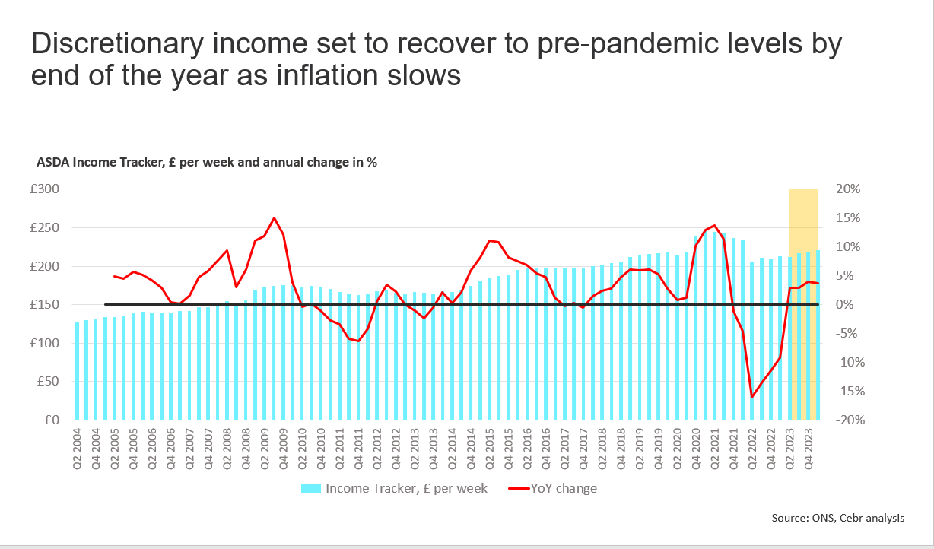

Slide 7
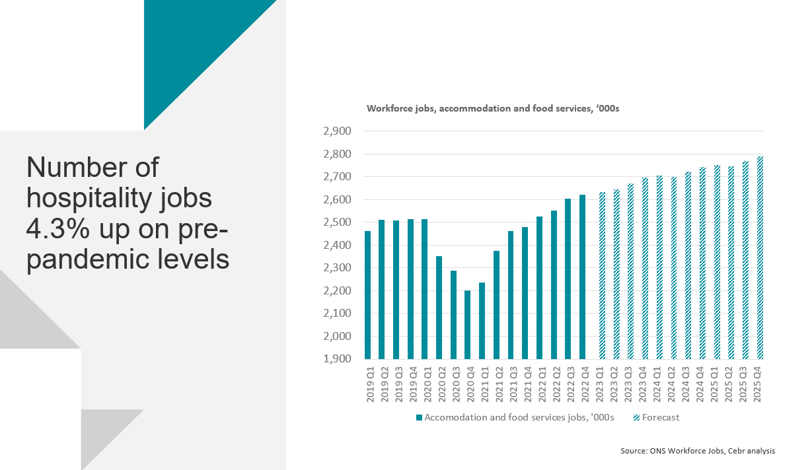

Slide 10
Industry update – boardroom agenda
CUSTOMER
PEOPLE
CAPEX
FINANCING
SUSTAINABILITY

Slide 11
Corporate tax update
James D Welch Corporate Tax Partner

Slide 12
Tax agenda
Overview on corporation tax - James Welch
Governance – Natasha Patel
Employment tax – Jacqui Roberts
VAT – Martyne Pearson

Slide 13
Current corporation tax landscape
Corporation tax rates now at 25% effective from 1 April 2023.
Important to maximise statutory reliefs
Interest relief – many restrictions to consider
Anti-hybrid rules,
Corporate interest restriction,
Transfer pricing,
anti-avoidance rules

Slide 14
Capital allowances – Goodbye super deduction hello full expensing
Super-deduction (130%) and Special rate allowance (50%) ends on 31 March 2023
Main Pool - Full expensing for qualifying expenditure from 1 April 2023 for 3 years
Special Rate Pool - 50% first year allowance from 1 April 2023 for 3 years
Amount of expenditure that can qualify is uncapped
Expenditure on new and unused plant and machinery
FYAs are optional therefore full expensing not automatic and will need to be claimed
Full detailed records needed to ensure correct treatment when sold

Slide 15
Tax optimisation
Pros and cons of grouping companies
Best time to plan for disposal is on acquisition
Tax planning – commercial motive
Engagement with HMRC

Slide 16
Tax governance
Natasha Patel Tax Director

Slide 17
Tax GOVERNANCE
SAO update
Business Risk Review
CCM application process
CCO
main areas of focus for Hotel clients
HMRC investigations
Responsible tax
Building this into your ESG agenda

Slide 18
Employment tax update
Jacqui Roberts Employment Tax Associate Director

Slide 19
Employment tax Matters
Service charge and tips
Employment Bill received Royal Assent 2 May 2023
As early as 2024?
Expected to affect 2 million workers
Obligation to pay over 100 % of worker or employer received tips to workers (including agency workers);
Tips, service charge (however described) mandatory or discretionary
Includes vouchers, stamps, tokens or similar item
Casino chips included/bottle of wine excluded
Must be distributed fairly between workers at that 'same place of business'
Allocation of discretionary tips 'fairly' through a Tronc arrangement are excluded
Paid by the end of the month following receipt by the employer
Includes agency workers
Formal tip policy must be implemented
Employees can request details of employer’s policy and employer tips distribution records

Slide 20
Employment tax Matters
Service charge and tips
Draft Code of Practice to be published by Secretary of State
Consulting with ACAS
Other Representations
Draft COP will be laid before Parliament
Employment tribunal with the power to compensate workers for failures and fine the employer

Slide 21
indirect taxes Update
Martyne Pearson VAT Partner

Slide 22
Agenda
VAT Groups
Penalties
Changes to Option to Tax Process

Slide 23
Vat GROUPs
Revenue and Customs Brief 5 (2022): Revised Guidance on dealing with VAT grouping registrations
Delays with the processing of VAT group applications – causing issues for taxpayers.
HMRC have decided that if an application is currently awaiting a response from them, you should:
treat the application as provisionally accepted on the date you submitted it online or the date it should be received by HMRC if you submitted it by post
account for VAT accordingly
What is the impact?
Lack of filing means HMRC will continue to issue assessment letters and requests for payment whilst this application is awaiting processing. The guidance has stated that these are to be ignored although this does not give much comfort to clients.
Filing VAT returns in the interim will cause issues with backdating the grouping application to the original requested date.
7

Slide 24
PENALTIES FOR LATE SUBMISSION OF RETURNS/PAYMENTS
Late submission
Late payment
Applies to both VAT and ITSA
New points-based penalty regime
Effective for VAT periods starting on or after 1 January 2023
Points accrue separately for VAT and ITSA
£200 fixed financial penalty - after point threshold is reached
Point threshold – dependant on submission frequency
Annually – 2 points
Quarterly – 4 points
Monthly – 5 points
Late payment penalty (First Charge) – payable 30 days after the payment due date
0 to 15 – no penalty
16 to 30 – 2%
Day 31 – 2% of what is due at day 15, plus 2% of what was due at day 30.
Late payment penalty (Second Charge)- Payable from day 31 and accrues on a daily basis.
8

Slide 25
PENALTIES FOR LATE SUBMISSION OF RETURNS/PAYMENTS
Impact?
This is an important development because under the new penalty points system, penalties can be incurred even on nil and repayment returns. To reduce a taxpayer’s points to nil, they must pass a “test of good compliance”, the duration of which varies dependent on the frequency of returns.
A taxpayer will be required to submit the following VAT returns on time during your period of compliance as well as all outstanding returns must be submitted:
Accounting Period | Period of Compliance | Returns to Make
Annual | 24 months | 2
Quarterly | 12 months | 4
Monthly | 6 months | 6
9

Slide 26
Option to Tax
What has changed on HMRC's side?
HMRC’s position has changed
BEFORE 1 FEBRUARY 2023:
Check notifications to confirm valid
Issue an acknowledgement letter
Confirm existence of option to tax
FROM 1 FEBRUARY 2023:
No longer will check validity
Emphasis on businesses to get right
No acknowledgement letters (email ‘receipt’)
Might impact how notification is made
Confirm existence of option to tax in limited circumstances
For an option to tax in respect of a property to be valid, it must be notified to HMRC within 30 days, and prior to the ‘relevant date’ (usually before the creation of a tax point) if an acquisition would be subject to VAT, and the intention is for an acquisition is to be a VAT-free Transfer of a Going Concern (TOGC).
17

Slide 27
Option to Tax
Impact for businesses?
Evidence of a valid option to tax important where:
VAT registration dependent on option to tax
Share transactions
Asset transactions
Impact:
How businesses choose to notify
Record keeping - evidence of notification/receipt by HMRC
Contractual wording may require updating to reflect the position that HMRC will no longer formally acknowledge options to tax, and it may result in delays to transactions.
In addition, there may be uncertainty as regards whether an option to tax notification is valid because of the lack of HMRC verification, e.g. whether it has been signed by an authorised signatory, or appropriate permissions have been received.
Keep detailed records of options to tax notified to HMRC and the automated email responses.
Maintain an option to tax register?
Consider the option to tax position in respect of a transaction should also be considered at an early stage, to avoid delays.
18

Slide 28
Corporate Governance
Mark RA Edwards Audit Partner
Head of Leisure & Hospitality

Slide 29
Key updates

Slide 30
Key updates

Slide 31
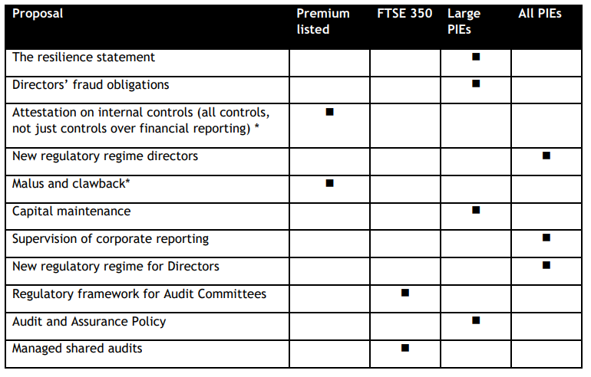
Key updates

Slide 32
Audit update
Mark RA Edwards Audit Partner
Head of Leisure & Hospitality

Slide 33
Key updates
Audit market update
Disclosure requirements and updates
IFRS updates
FRS 102 updates

Slide 34
Q&a

Slide 35
Our SPEAKERS
Today’s panel
JANE PENDLEBURY
HOSPA Chief Executive
MARK RA
EDWARDS
Partner
Audit
JAMES D WELCH
Partner
Tax
JACQUI
ROBERTS
Associate Director
Employment Tax
MARTYNE PEARSON
Partner
VAT Services
NATASHA PATEL
Director
Tax

